Slide 1


Designing Mobile Applications with Xamarin
A best practices guide for optimum mobile cross platform development.

Slide 2
Who?
Jerel R Hass
@agies1
jhass@quicksolutions.com

Slide 3
What is Xamarin?
Xamarin the product is about writing code in a single language (C#) to support the major development platforms, such as; iOS, Android and WP8.
Xamarin the Company can be read about at the end of this http://xamarin.com/faq

Slide 4
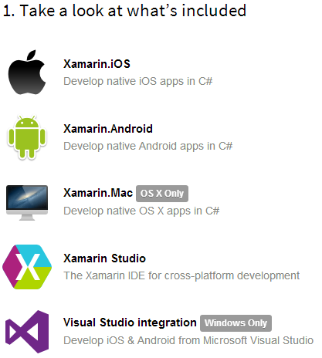
A Tour Around Xamarin
Downloading Xamarin - http://xamarin.com/
Looking for Hype - http://xamarin.com/tour
Need more help - http://developer.xamarin.com/

Slide 5







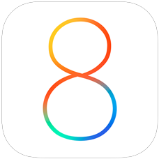
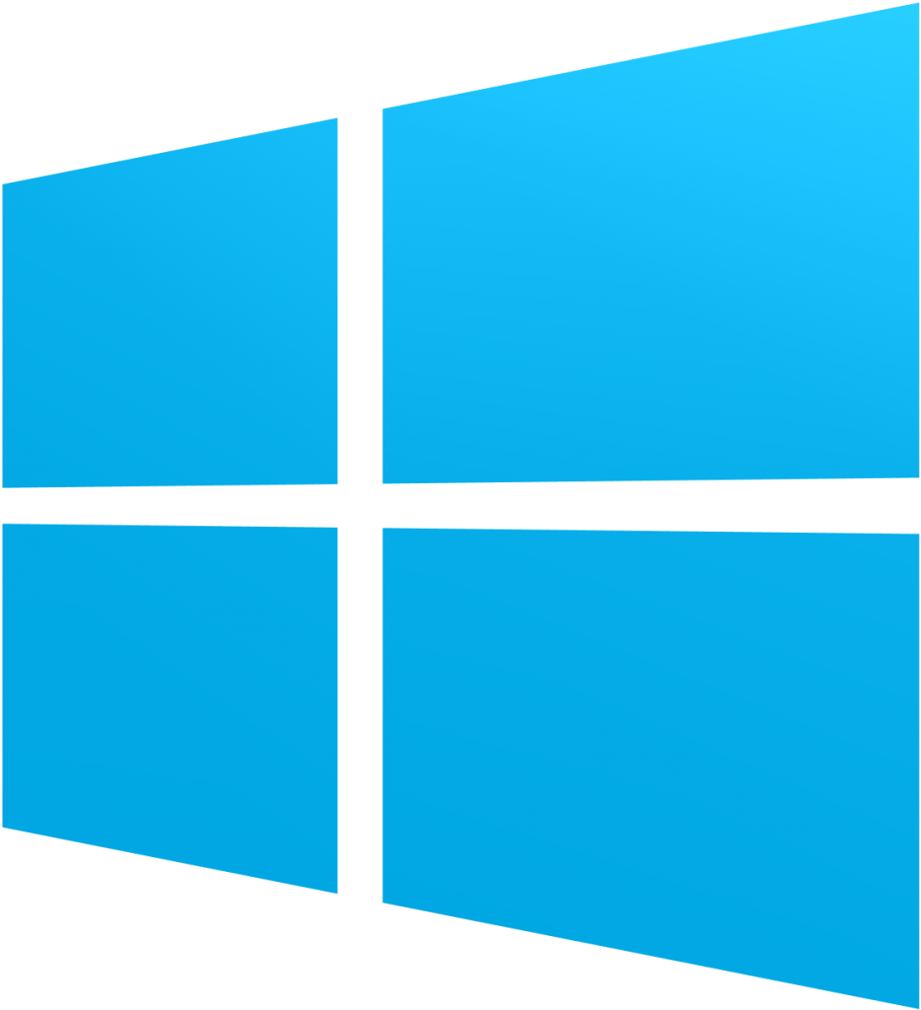
Why Xamarin?
C# + .Net Now backed by Open .Net
Modern Language
Modern IDE
Native API Access
Native Look and Feel
You can still use Html!
Nuget
Components
90% Code Reuse

Slide 6
How Xamarin Works

Slide 7
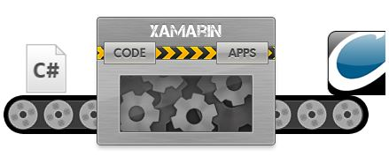

How Xamarin Works?
Put C# in one side and Applications pop out the other side, and get paid for it. Done!

Slide 8
How Xamarin Really Works
iOS, Xamarin’s Ahead-of-Time ( AOT) Compiler compiles Xamarin.iOS applications directly to native ARM assembly code.
Android, Xamarin’s compiler compiles down to Intermediate Language ( IL), which is then Just-in-Time ( JIT) compiled to native assembly when the application launches.
By Exposing a .Net like Native Layer

Slide 9
Installing Xamarin
Endpoint Whitelist - http://developer.xamarin.com/guides/cross-platform/getting_started/installation/firewall/
Installing On PC
Installing On Mac
Requirements
iOS Development: Mac + iOS Device
Android Development: (PC or Mac) + Android Device
WP8 Development: PC + WP8 Device
Notes:
Installing on a PC, you will need to configure a Mac Build Host, if doing iOS Development.

Slide 10
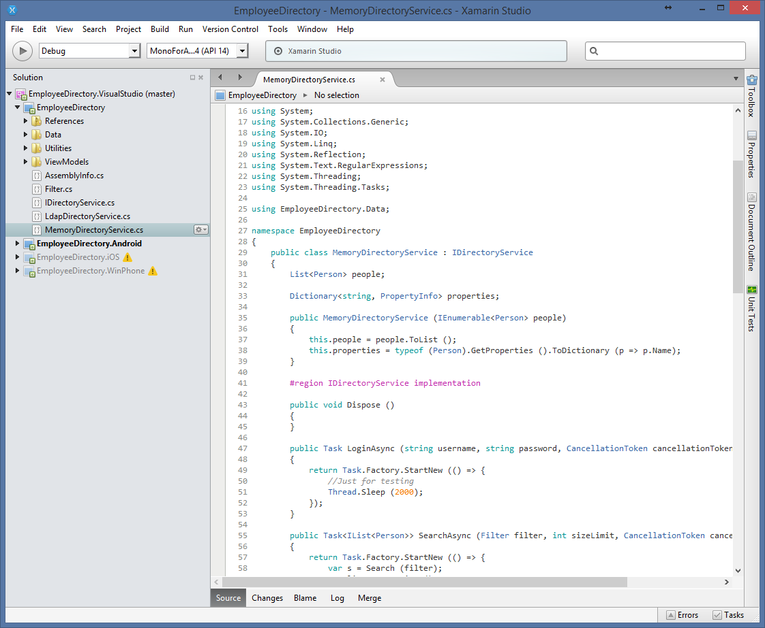
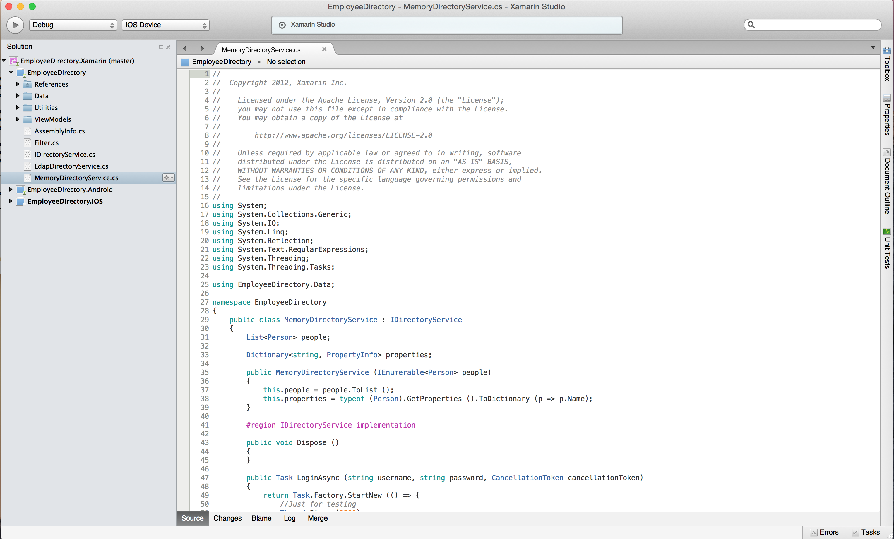
Xamarin Studio
PC
MAC

Slide 11
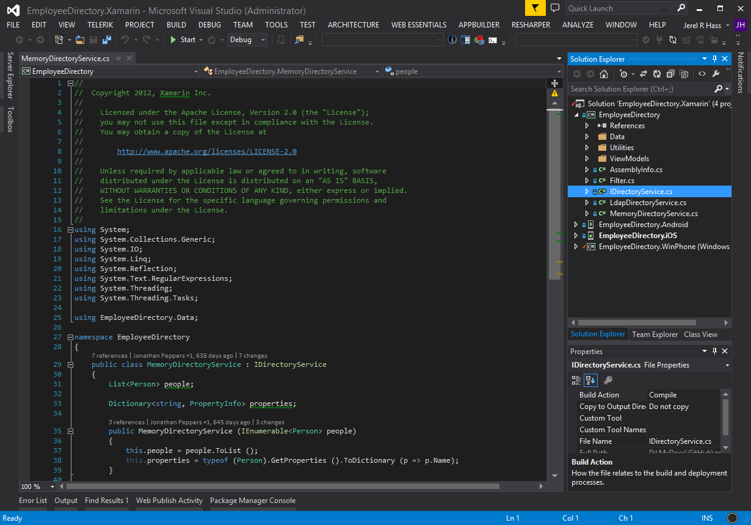
Visual Studio: Extension

Slide 12
Ensure Everything is Ready
Proper preparation

Slide 13
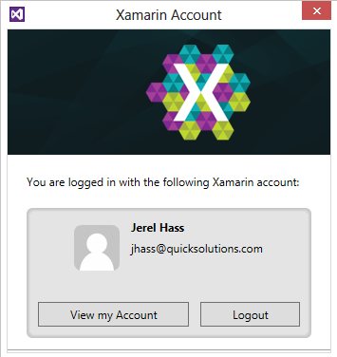
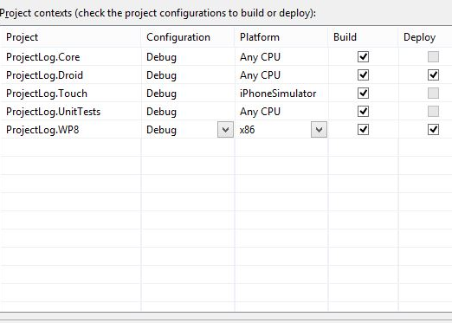
Pre-Dev Check List
Xamarin Account is Ready
Solutions are Deploy Ready
Emulators/Devices are Awake
If Using Devices are they provisioned?

Slide 14

Building a Cross Platform Application
Mobile Project Log

Slide 15
Example Stories
Mobile Project Log
As a User I should be able to run my application on the three major platforms
As a User we should be able to view a List of our Projects
As a User we should be able to view our Team
As a User we should be able to use the Camera to Upload “Status Reports”
As a User we should be able to use the Microphone to Record “Note”
As a User we should be able to store data locally to synchronize later

Slide 16

Laying out the Solution
Typical Architecture
XXXX.Core (Portable Class Library)
XXXX.Touch (MonoTouch iOS App)
XXXX.Droid (MonoDroid Android App)
XXXX.WP8 (Windows Phone 8 app)

Slide 17
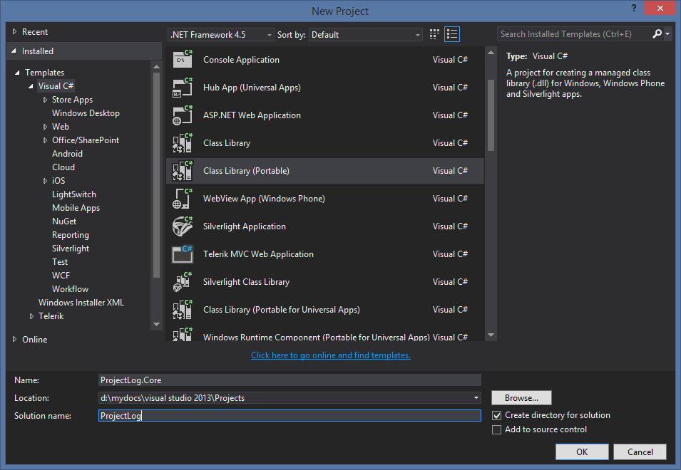
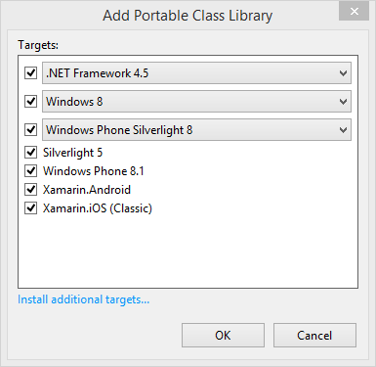
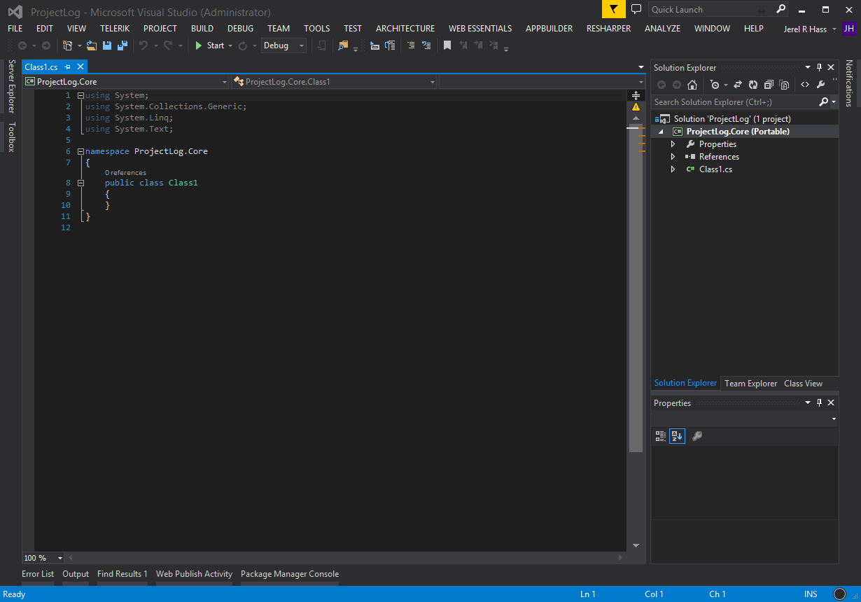
Adding the Portable Class Library

Slide 18
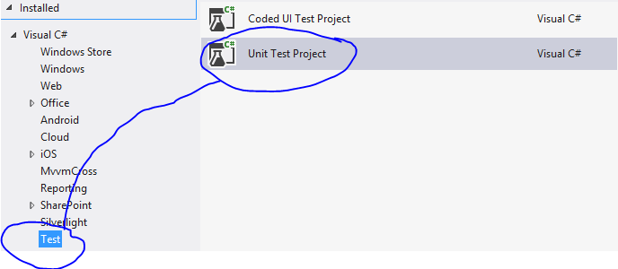

Adding a Test Library

Slide 19
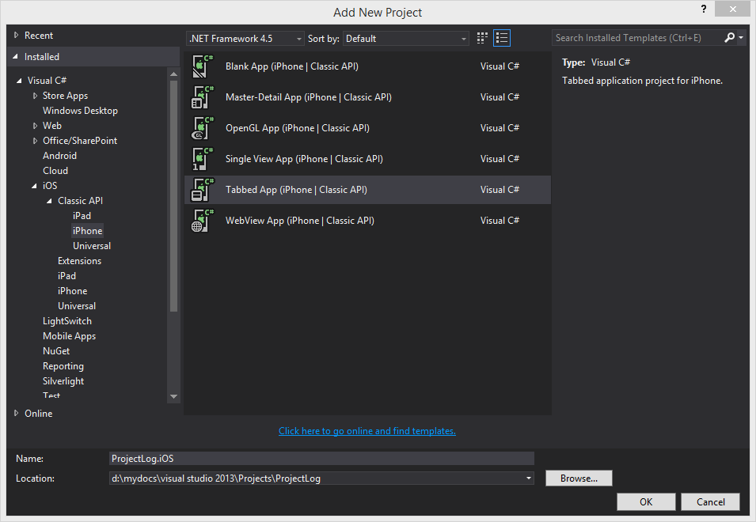
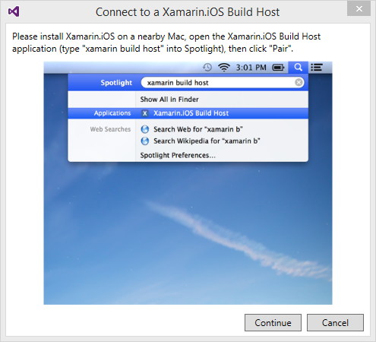
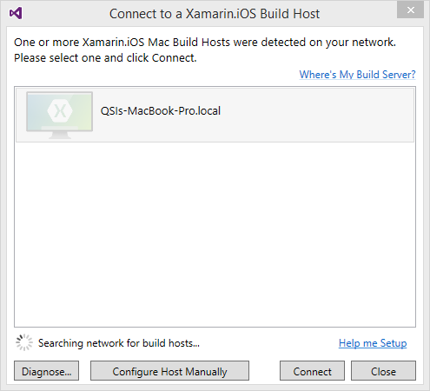
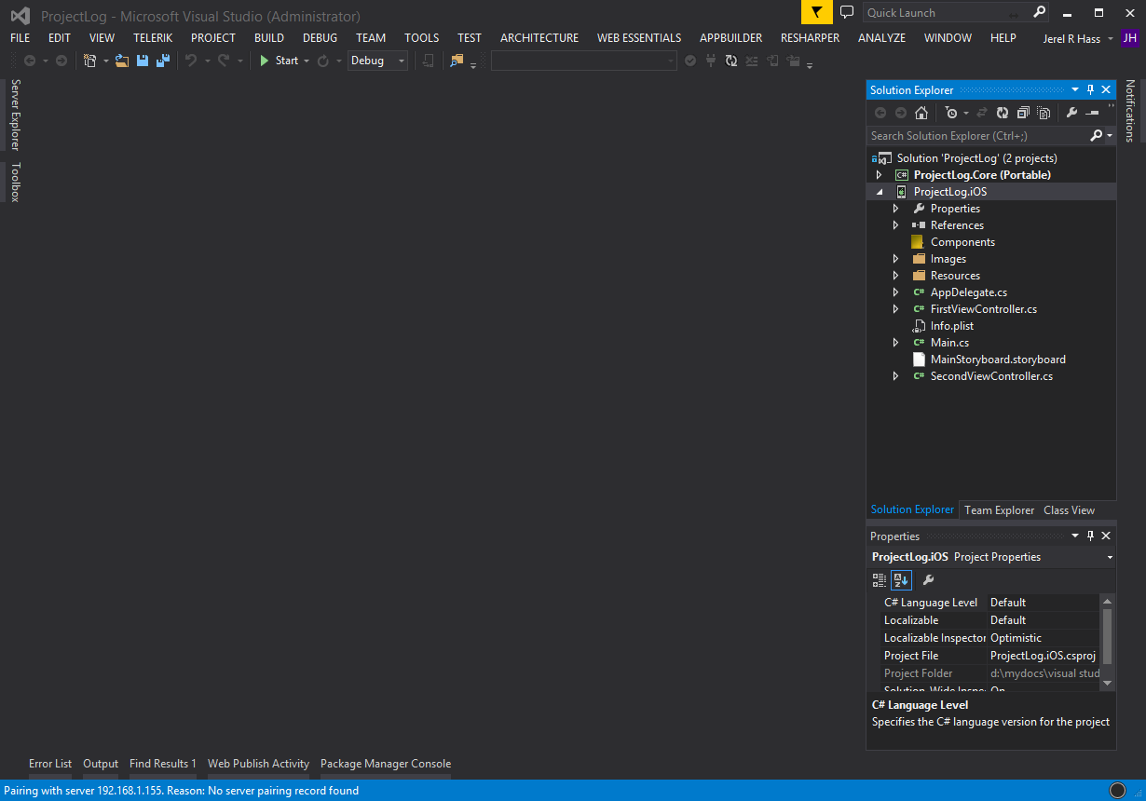
Adding the iOS Application

Slide 20
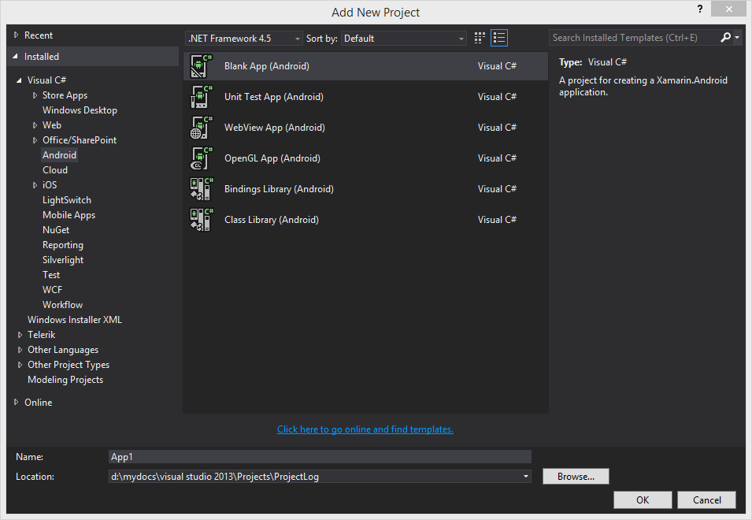
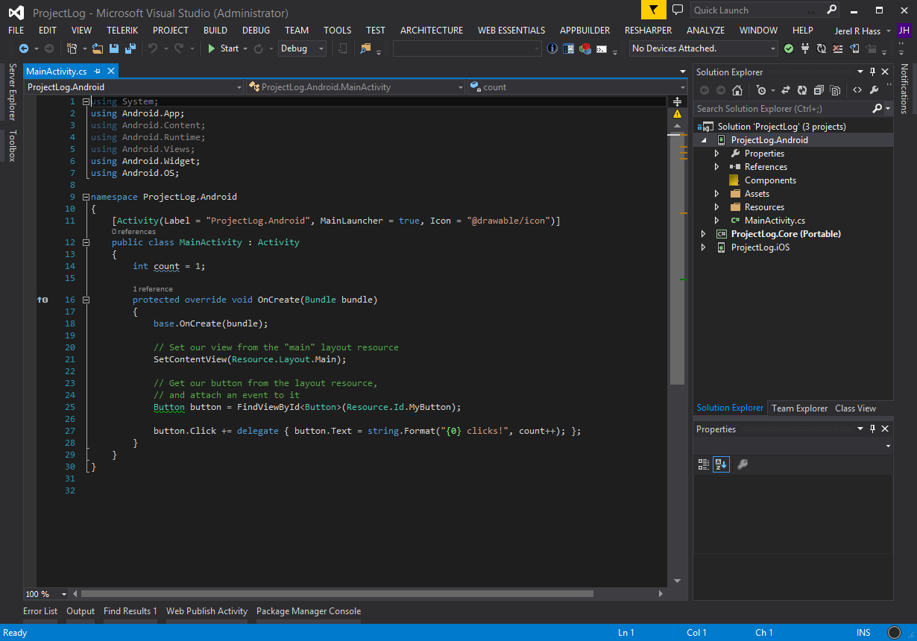
Adding the Android Application

Slide 21
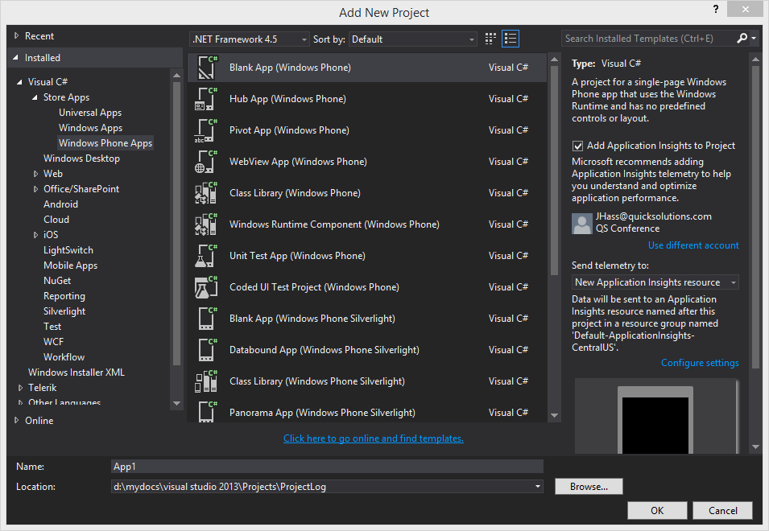
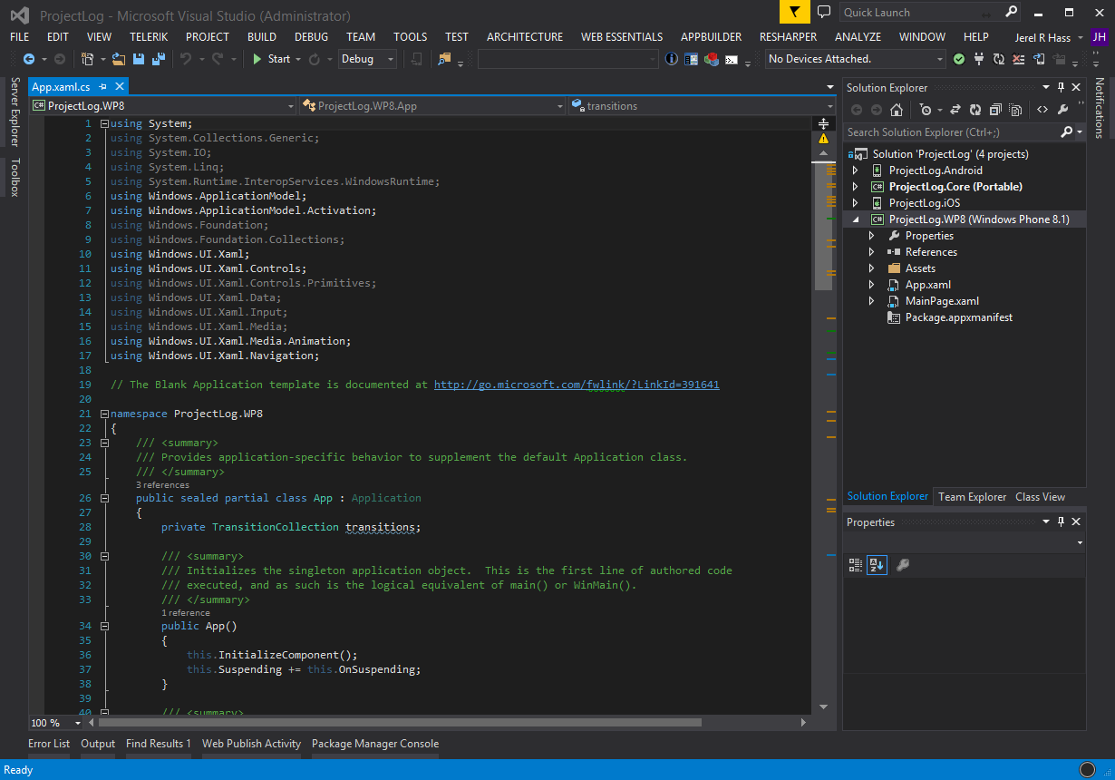
Adding the WP8 Application

Slide 22
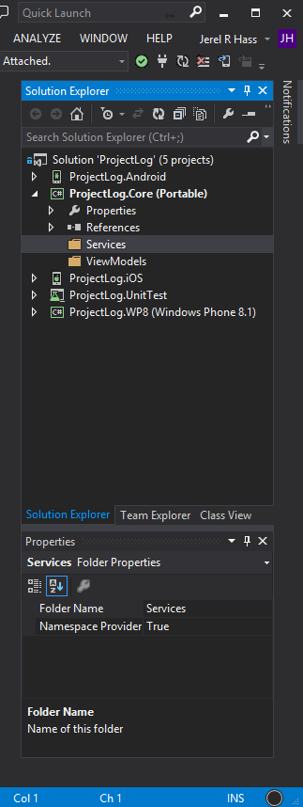
Structure Completed
We are ready to start writing some code.

Slide 23
Building the Business
Here comes the fun

Slide 24
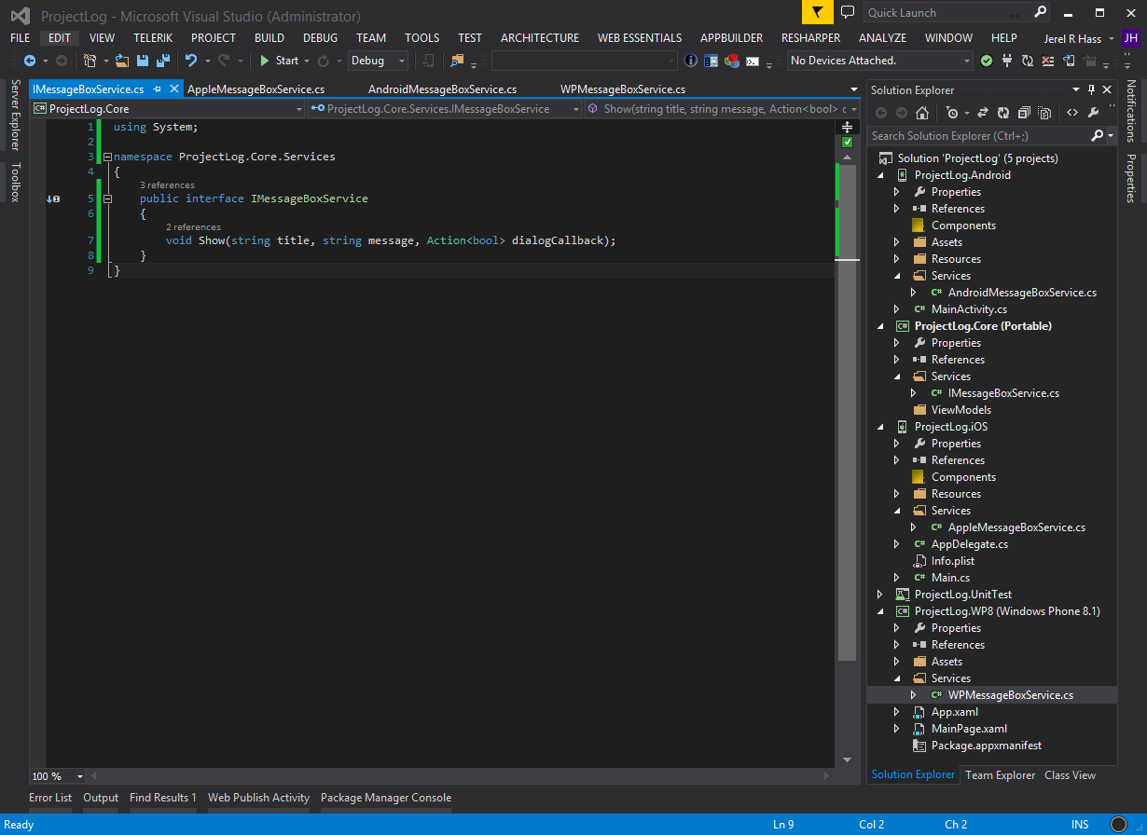
One of Many Architectures
Simple Architecture
Future:
IoC
Binding

Slide 25
Why Portable Class
Here is an example implementation of a Service with the Portable Class model.
IFoo
AndroidFoo
AppleFoo
WPFoo

Slide 26
Why Portable Class Cont…

Slide 27
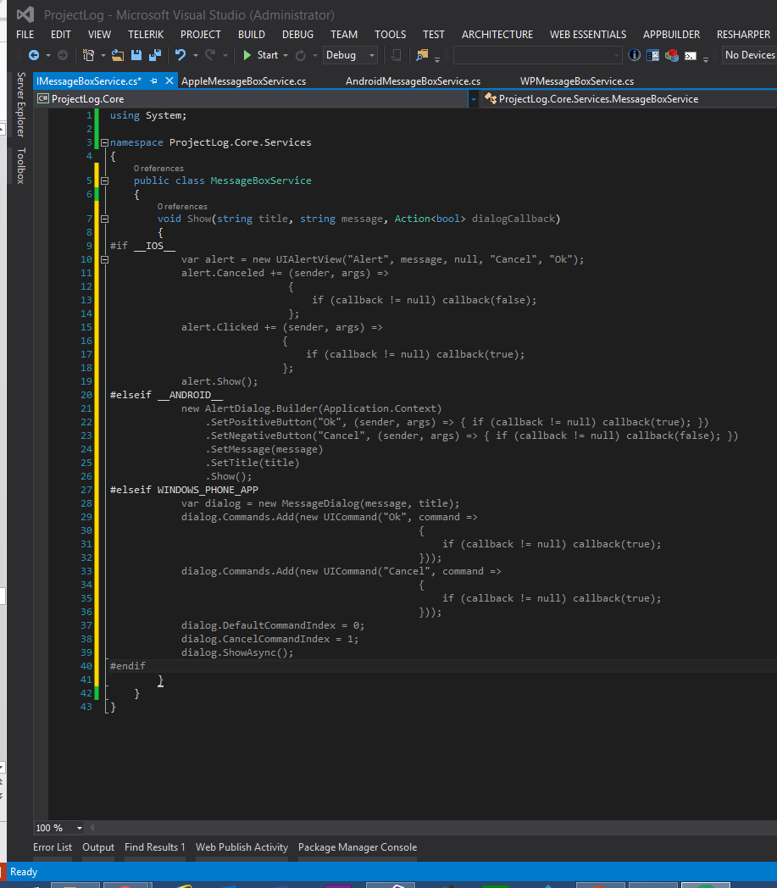
Shared Class Example

Slide 28
Plug the Service in
using ProjectLog.Core.Services;
namespace ProjectLog.Core.ViewModels
{
public class ShellViewModel
{
private readonly IMessageBoxService _messageBoxService;
public ShellViewModel(IMessageBoxService messageBoxService)
{
_messageBoxService = messageBoxService;
}
}
}

Slide 29
Building Native Views
Time to Get Designee

Slide 30
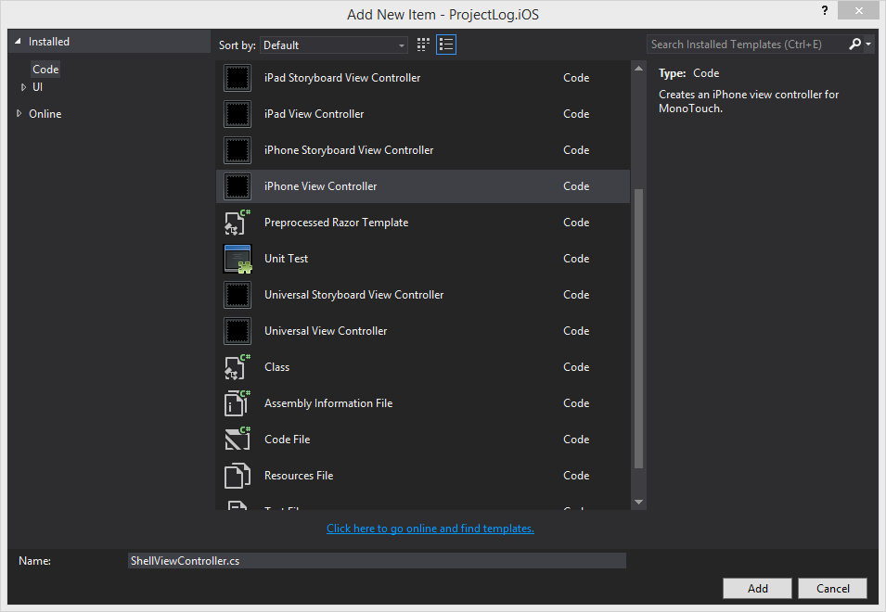
Creating an iOS View in XCode
The Plan
Switch to the Mac
Open Xamarin Studio
Create a Generic iOS View
Build the View In Xcode

Slide 31
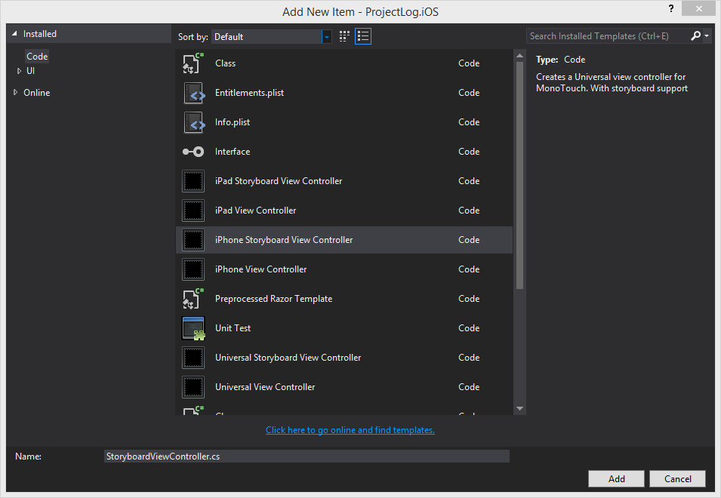
Creating an iOS View in VS
The Plan
Stay on PC
Create Storyboard View
Edit in Visual Studio

Slide 32
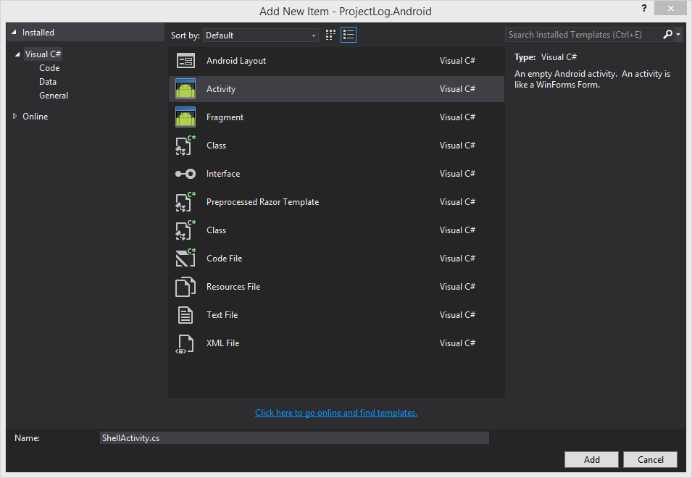
Creating an Android View
The Plan
Create an Activity
Create a Layout File
Build
Bind the two together

Slide 33
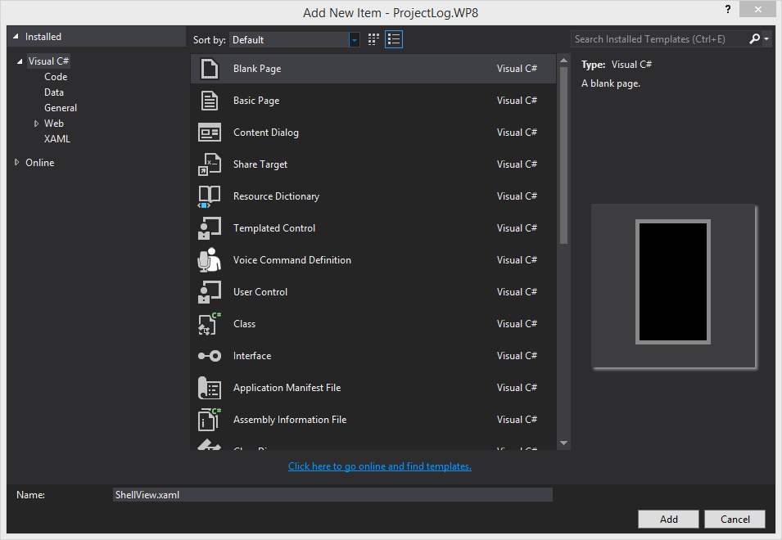
Creating a WP8 View
The Plan
Create a new WP8 view
Whistle a tune, to fill time

Slide 34
Driving the Views with our ViewModel
iOS
Controller Actions are passed through the VMs Commands
Controller View Changes Update the VMs properties
Android
Controller Actions are passed through the VMs Commands
Controller View Changes Update the VMs properties
WP8
Databind the VM to the View

Slide 35
Xamarin.Forms
Xamarin.Forms is a cross-platform natively backed UI toolkit abstraction that allows developers to easily create user interfaces that can be shared across Android, iOS, and Windows Phone. The user interfaces are rendered using the native controls of the target platform, allowing Xamarin.Forms applications to retain the appropriate look and feel for each platform.

Slide 36
Xamarin.Forms Advantages
Write One UI
Supported by Native Controls
Databinding Supported out of the box
Third Party Support

Slide 37
Xamarin.Forms Disadvantages
Can be slow with complex UIs
Is not supported within the Free License
Limited Design Options

Slide 38
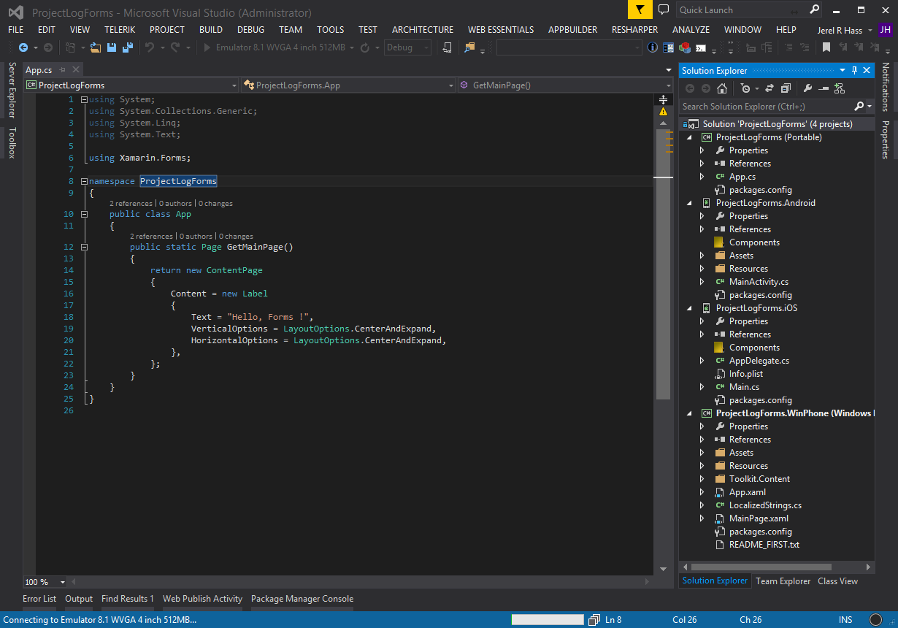
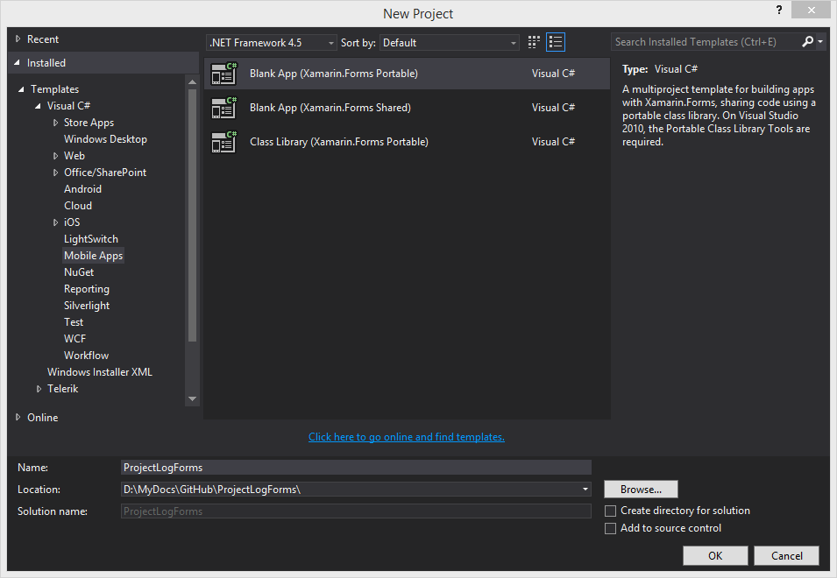
Creating a Xamarin.Forms App

Slide 39
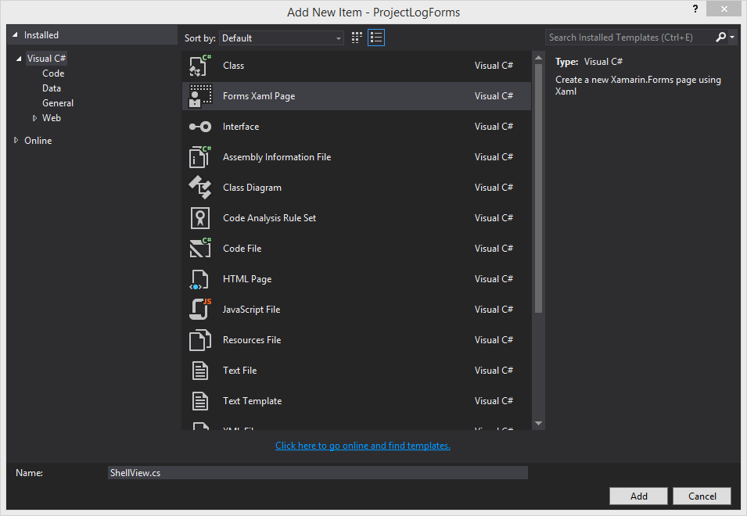
Create a Xamarin.Form View
<?xml version="1.0" encoding="utf-8" ?>
<ContentPage xmlns="http://xamarin.com/schemas/2014/forms"
xmlns:x="http://schemas.microsoft.com/winfx/2009/xaml"
x:Class="ProjectLogForms.ShellView">
<Label Text="{Binding MainText}" VerticalOptions="Center" HorizontalOptions="Center" />
</ContentPage>

Slide 40
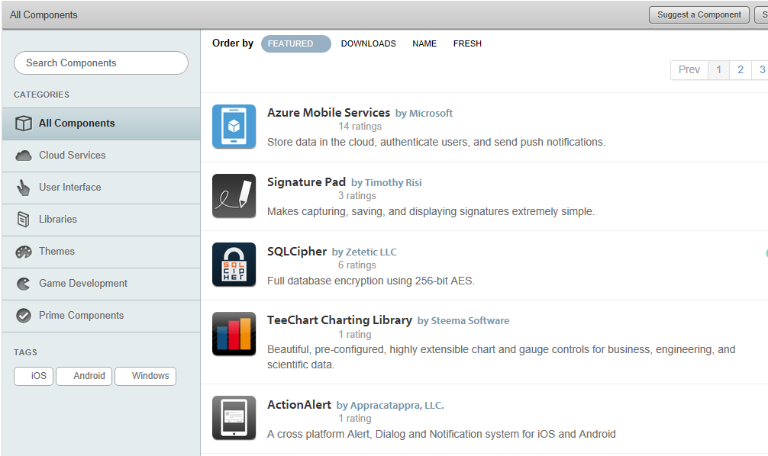
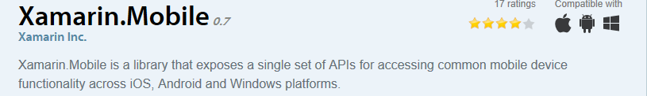

Adding Components

Slide 41
Adding Components Cont…
Why?
Wrap Native Code, make a more neutral API
Offer Productivity Add-in
Normal Third Party Reasons

Slide 42
Native APIs
Keep Platform specifics on that Platform
Avoid Compiler Directives
Wrap Native calls for better testing

Slide 43
Neutralizing Platform Differences with MVVMCross
Now for the Good Stuff

